Slide 1

Urban Food Deserts
Mary Bellavia, David Fournie, Janelle Goddard, and Eric Evans

Slide 2
What is a food desert?
The definition of food deserts differs, though, based upon whether one lives in an urban or a rural setting. In fact, according to a Newsweek article published in 2014, “[I]n urban areas, the U.S Department of Agriculture considers a food desert an area with no ready access to a store with fresh and nutritious food options within one mile. In rural America, a food desert is defined as 10 miles or more from the nearest market.
We focused on Urban areas
In poorer areas, people may not have their own transportation and rely on public transportation or walking.
Moveforhunger.org

Slide 3
Unfortunately, food deserts are not few and far between, it’s estimated there are more than 23 million people, more than half of them low-income, living in food deserts.
Moveforhunger.org

Slide 4
We considered….
The counties in Missouri
Population as of 2010
Poverty rate
Various races (White, African American, Asian, Hispanic) living ½ mile to 1 mile from a grocery store

Slide 5
Questions that we asked…..

Slide 6
Demographics

Slide 7
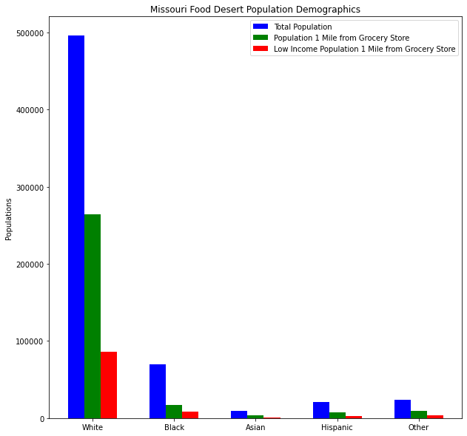

Slide 8
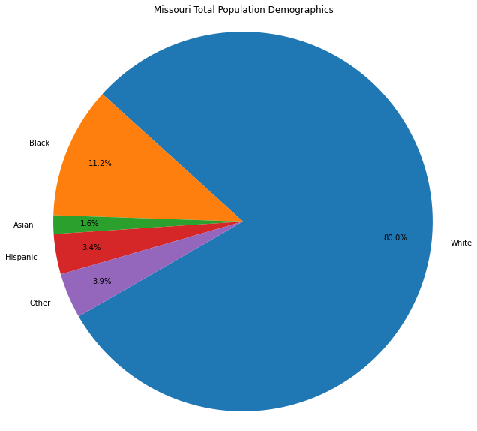

Slide 9
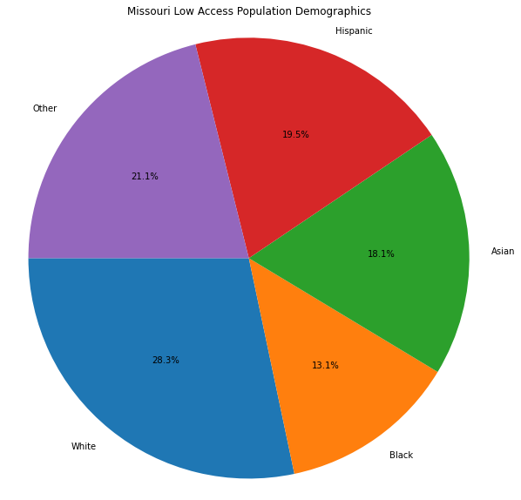

Slide 10
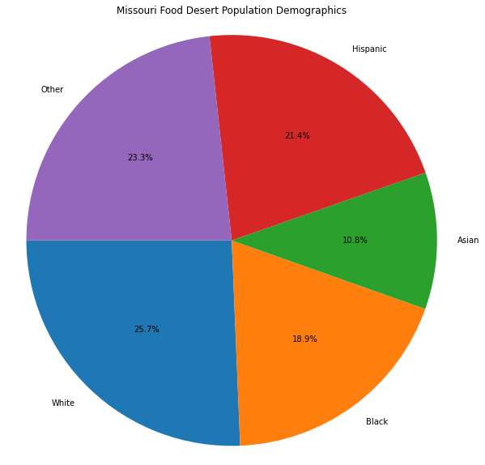

Slide 11
Food enviroments

Slide 12
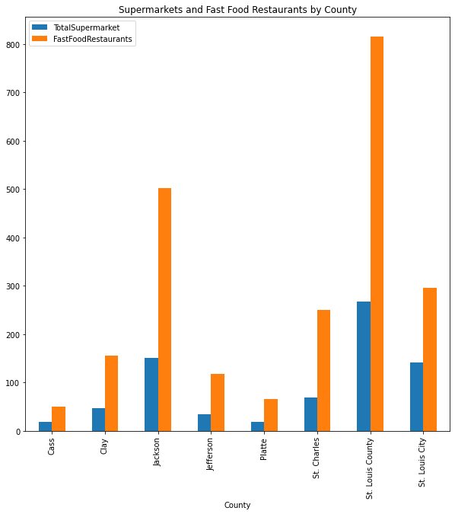

Slide 13
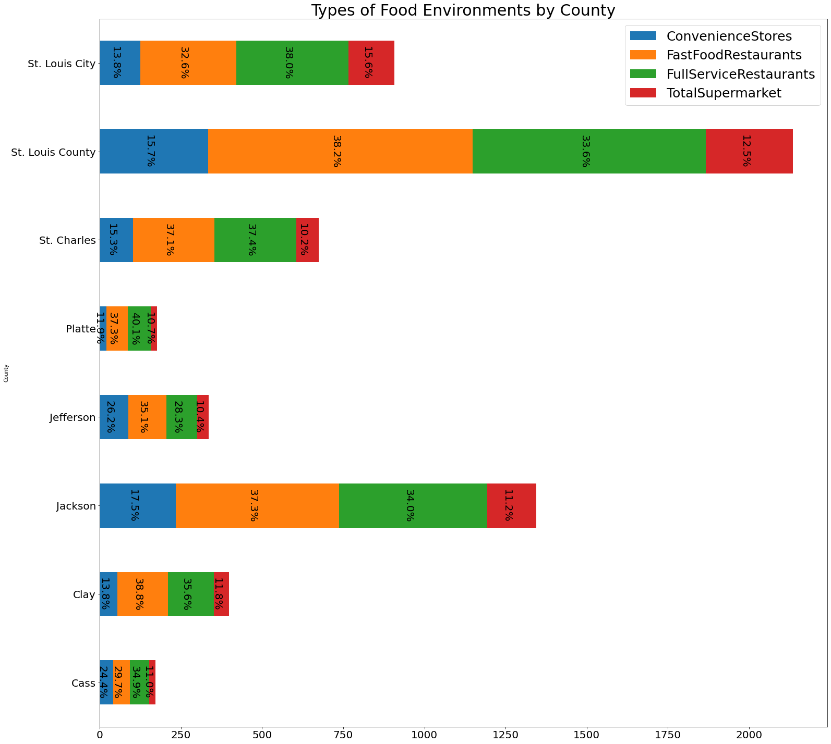

Slide 14
Poverty Rates Low Access analysis

Slide 15
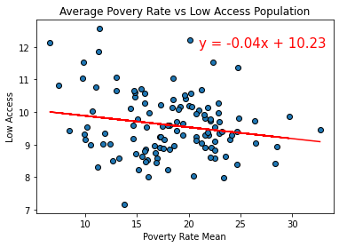

Slide 16
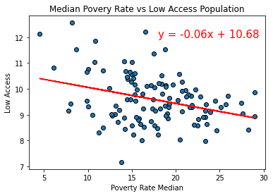

Slide 17
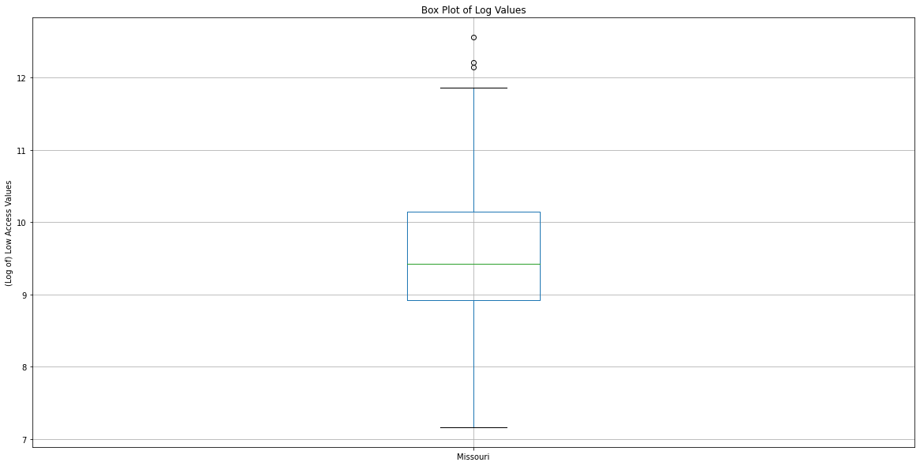

Slide 18
Questions?

